Slide 1
CHAPTER 12 RESPIRATION IN PLANTS

Slide 2
The process of Breaking of C-C bonds of compound organic compounds through oxidation within the cell, leading to release of considerable amount of energy.
Respiratory substrate
The compound which oxidised during respiration.
  Carbohydrate,
  Protein
  Fat
  Organic acid

Slide 3
Do Plants Breathe?
Reasons for absence of Respiratory Organs in Plants

Slide 4
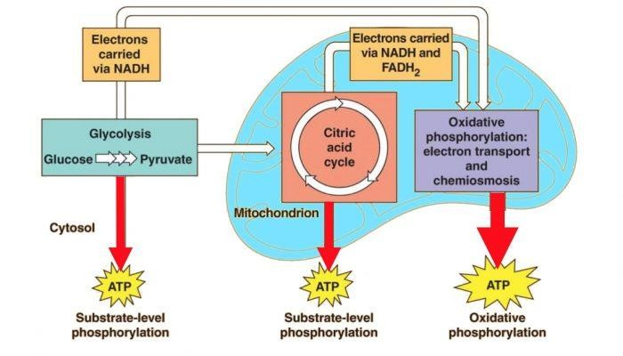

Slide 5
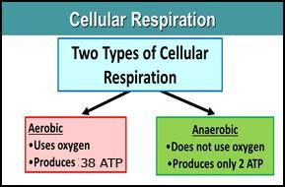

Slide 6
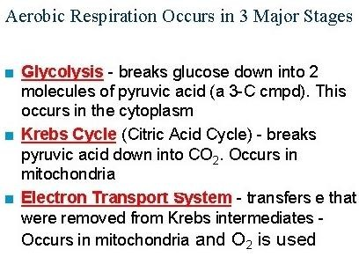

Slide 7
GLYCOLYSIS

Slide 8
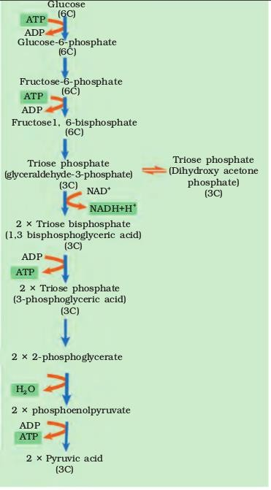

Slide 9
NET GAIN OF ATP IN GLYCOLYSIS

Slide 10
AEROBIC RESPIRATION
Crucial Events of Aerobic Respiration

Slide 11
PYRUVIC ACID [3C]
CO2
NAD⁺
COA
Pyruvate dehydrogenase
NADH+H⁺
[Mg²⁺]
ACETYL COA [2C]

Slide 12
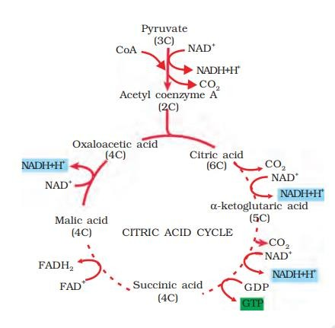
KREBS CYCLE / TCA CYCLE / CITRIC ACID CYCLE

Slide 14
ELECTRON TRANSPORT SYSTEM
Complex-1
Complex -2
Complex-3
Complex-4
Complex-5

Slide 15
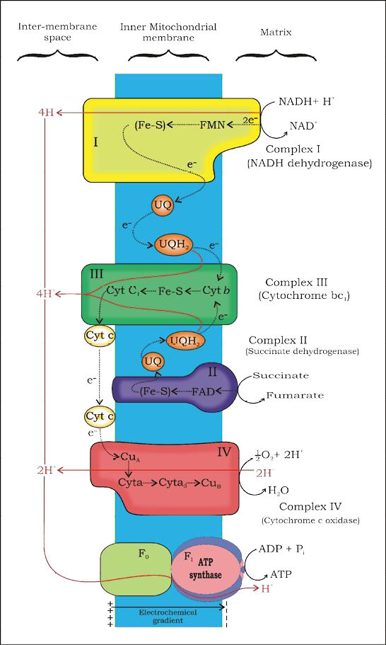
ELECTRON TRANSPORT SYSTEM & OXIDATIVE PHOSPHORYLATION

Slide 16
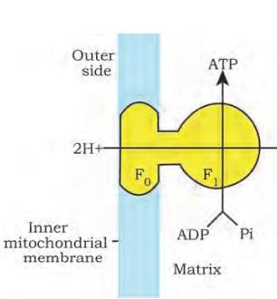

Slide 17
RESPIRATORY BALANCE SHEED
NET GAIN Glycolysis 1 Glucose → 2 Pyruvic Acid 4 ATP 2 NADH Since 2 is utilised in the pathway | ATP 4 6 | 8
 | 10 - 2
 | 8

Slide 18
LINK REACTION 2 Pyruvic acid 2 Acetyl co.A 2 NADH KRGB’S CYCLE 1 glucose 1 Pyruvic Acid 3 NADH 1 FADH2 1 ATP | ATP 6 9 2 1 | 6

Slide 19
2 Pyruvic Acid Yield’s
6 NADH
2 FADH2 2 ATP | 18 4 2 ---------- | 24
 | 24
NET GAIN |  | 38

Slide 20
FERMENTATION
1.Lactic acid Fermentation
2.Alcoholic Fermentation

Slide 21
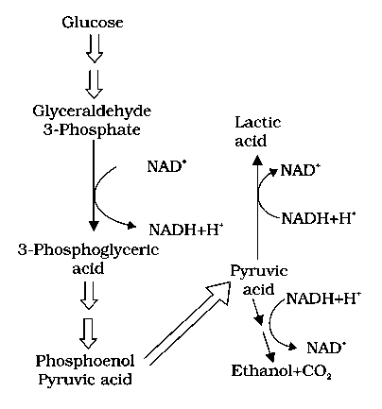

Slide 22
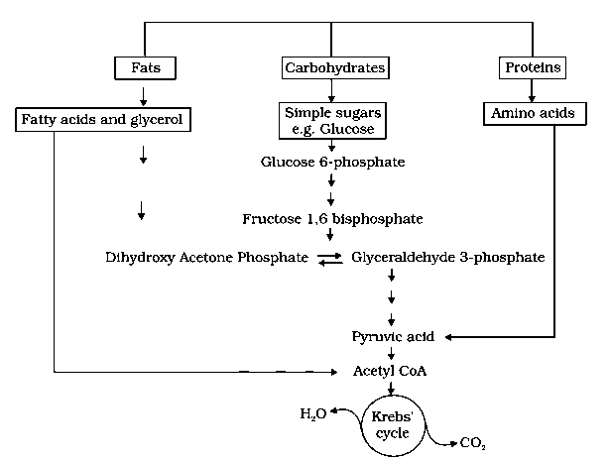
AMPHIBOLIC PATHWAY

Slide 23
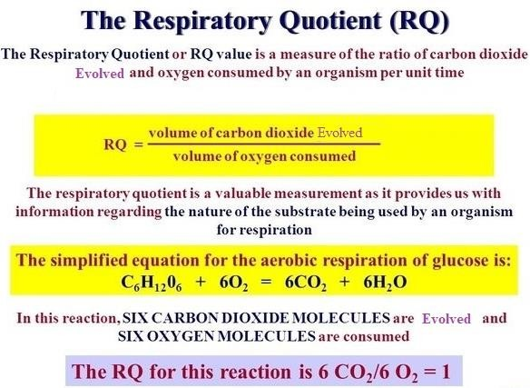

Slide 24
RQ FOR FAT [LESS THAN 1]
Eg: Tripalmitin
2 (C51 H98 O6) + 145 O2 →
102 CO2
RQ = --------------- = 0.7
145O2
102 Co2 + 98 H20 + Energy
RQ For Protein [Less than 1]
0.9

Slide 25







